Slide 1


STADIUM MANAGEMENT PORTAL
Prepared by: SHAH YASHVI
Enrolment no: 23002171210160
Roll no: 214
Branch: CSE

Slide 2
CONTENTS
PURPOSE
FLOWCHART
ER DIAGRAM
USE CASE DIAGRAM
FUNCTIONALITIES
TECHNOLOGIES USED
DATABASE SCHEMAS
MERITS AND DEMERITS
SCOPE

Slide 3
1. PURPOSE
This program is designed to handle the various aspects of stadium management system.
Including user registration, event and concert creating, viewing history and all users.
This platform provides a user-friendly interface for performing these actions through a series menu.

Slide 4
2. FLOWCHART
Start
|
Initialize DB Connection
|
Display Menu Option
|
User Authentication
|
Display Categories
|
Handle Errors
|
Return to Menu
|
End

Slide 5
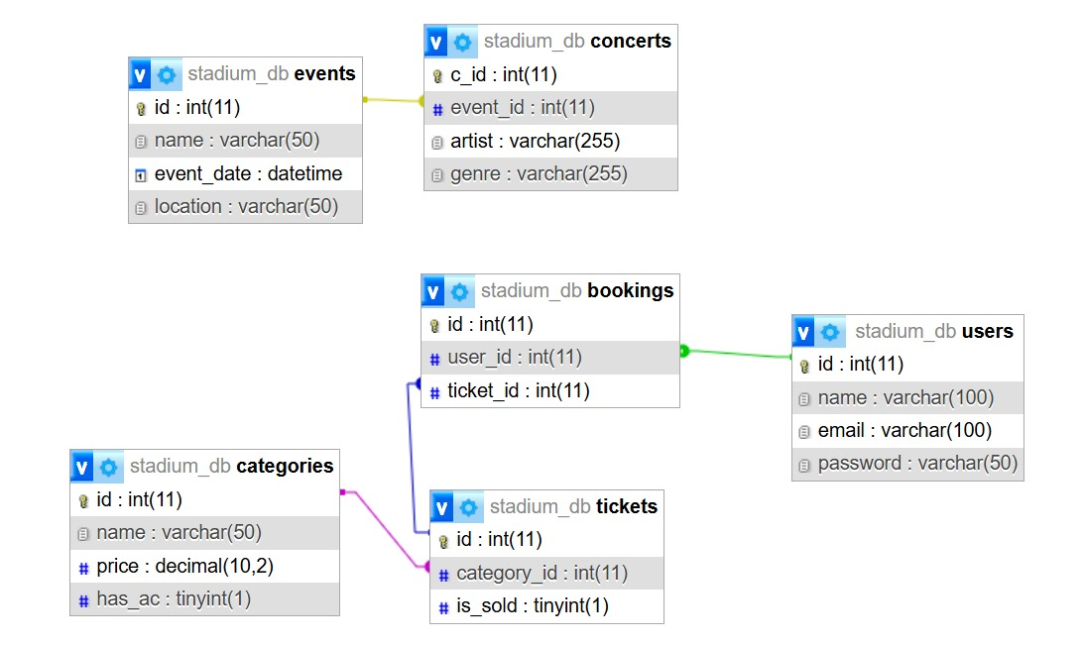
3. ER DIAGRAM

Slide 6
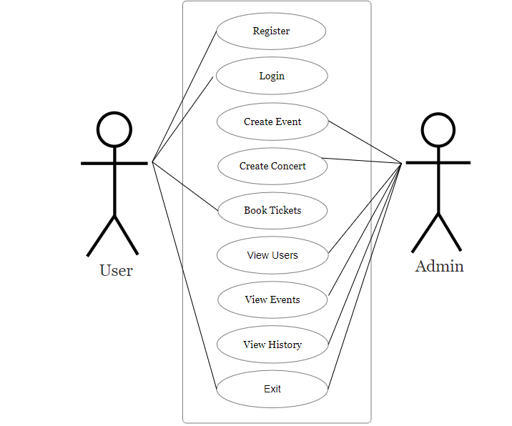
4. USE-CASE DIAGRAM

Slide 7
5. FUNCTIONALITIES
DATA STRUCTURE USING JAVA | JAVA-|| | DATABASE MANAGEMENT SYSTEM
1) Stack : to save the history of the users, events and booking. | Prepared Statement : To define SQL queries with placeholders and later those are filled with actual values. | 1) Crud Operations (create, read, update)
2) HashMap : It stores key-value pairs. Key represents a unique identifier and value represents object associated with key. | 2) Synchronized : To prevent the inconsistency between two threads calling simultaneously. | 2) Used the concepts of Primary key, Foreign key, Check, Not null ,Unique constraints.
3) Methods : put(key , value) get(object key) keyset() | In HistoryStack class addHistory() and ViewAllHistory() | 3) ER Diagram and Use Case Diagram

Slide 8
6.TECHNOLOGIES USED
Programming Language : Java
Database Management System : MySQL
Connectivity : JDBC (Java Database Connectivity)
Design and Documentation : Flowcharts for visualizing system architecture and processes

Slide 9
7. DATABASE SCHEMAS
TABLES :
bookings
categories
concerts
events
tickets
users

Slide 10
8. MERTITS & DEMERITS
MERITS
DEMERITS
Simple Interface
Interactive Commands
Synchronization(thread-safety)
No Data Export and Import
Limited Data Integrity checks
Basic Authentication

Slide 11
9.SCOPE
Implement Advanced Data Security
Real-Time Updates
Expand Functional Capabilities
Mobile Application

Slide 12
~~~THANK YOU~~~

